Slide 1


Diabetes Disease Prediction
By:
Mohammed Sareh Assiri
SADIA-Bootcamp
October 2021

Slide 2

1
Diabetes Disease Overview.
2
Dataset
3
Baseline.
Content
Outline
4
Predicting Diabetes using four model
5
Results
6
Modleling by choose the best score
7
Conclusion.
Topics for discussion

Slide 3

Prediciting Diabetes
Diabetes(DM): is a disorder that effecting insulin hormone-producing in the body.
Artificial intelligence is used as a machine learning representative to predict this disease.
My target variable is going to be a binary,
0 if the patient is doesn’t have DM, and 1 if
the patient is has DM.

Slide 4

Dataset
Pima Indians Diabetes Database
from Kaggle
https://www.kaggle.com/uciml/pima-indians-diabetes-database
Pregnancies: Number of times pregnent
Glucose: Plasma glucose
Blood Pressure: Diastolic blood pressure(mm Hg)
Skin Thickness: Triceps skin fold thickness(mm)
Insulin: 2-Hour serum insulin (mu U/m)
BMI: Body mass index (weight in kg/(height in m)^2)
DiabetesPedigreeFunction: Diabetes pedigree function
Age: Age(years)
Outcome: Class variable (0 or 1)

Slide 5
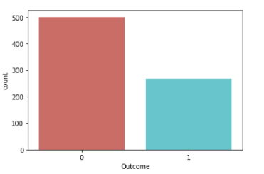

note:
0 and 1 imbalance
Intranasal Vaccines
Presentations are communication tools that can be used as demonstrations, lectures, speeches, reports, and more. It is mostly presented before an audience.

Slide 6
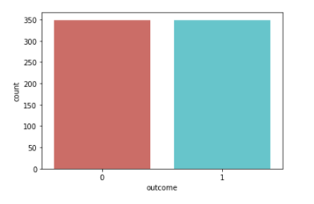

Outcome:
0 and 1 after use (smote) became balance

Slide 7
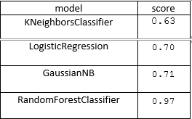
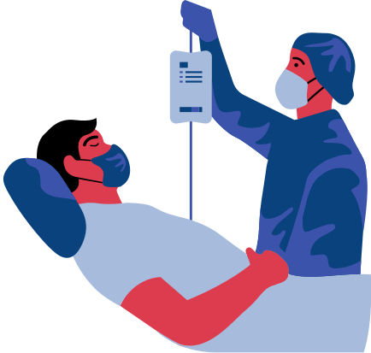
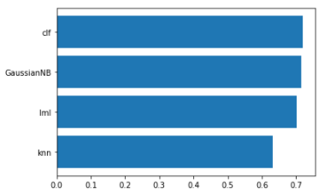
All models results
ARAICO PHARMACEUTICAL | VACCINES

Slide 8
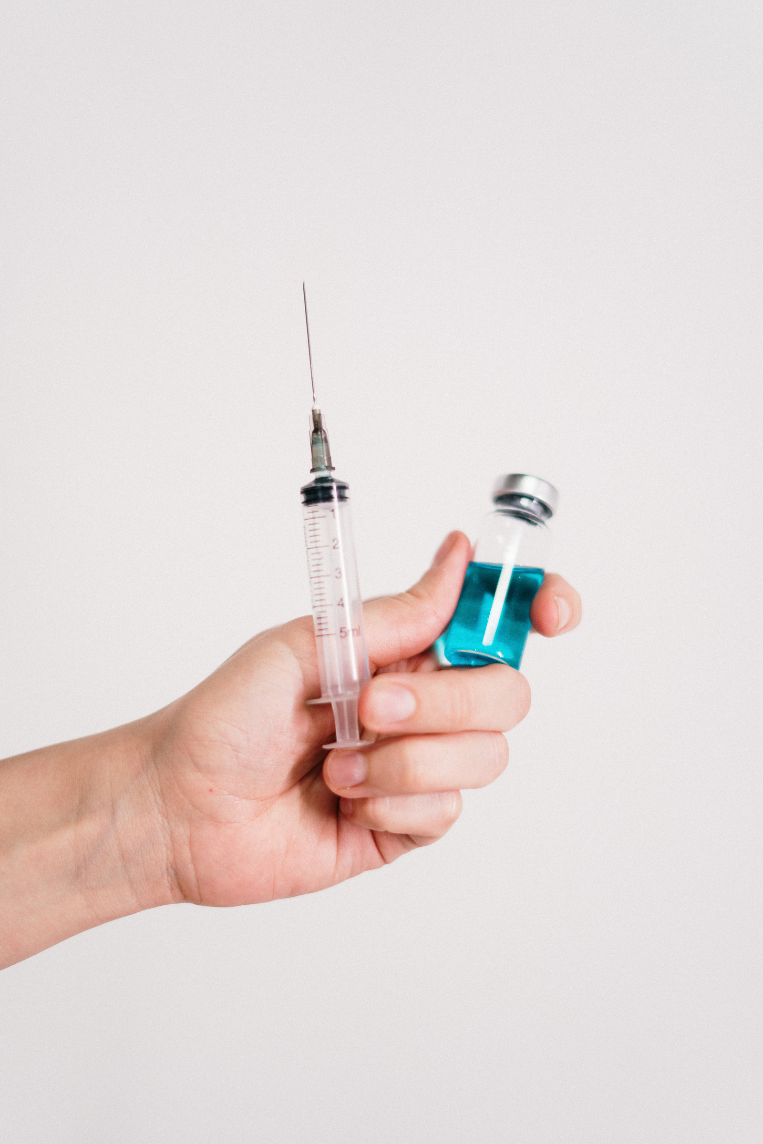
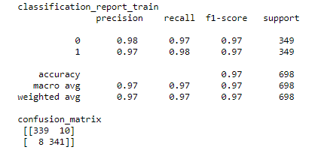
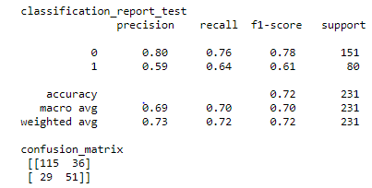
Classification report
and
confusion matrix

Slide 9
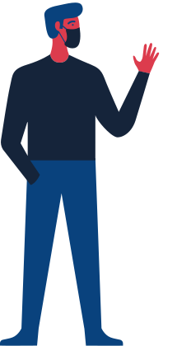
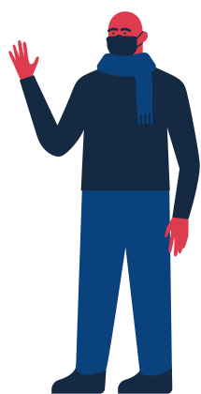
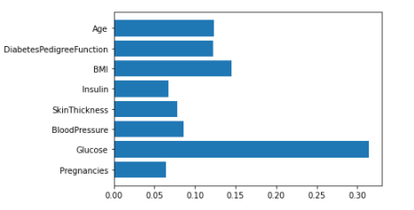
Features Importance

Slide 10

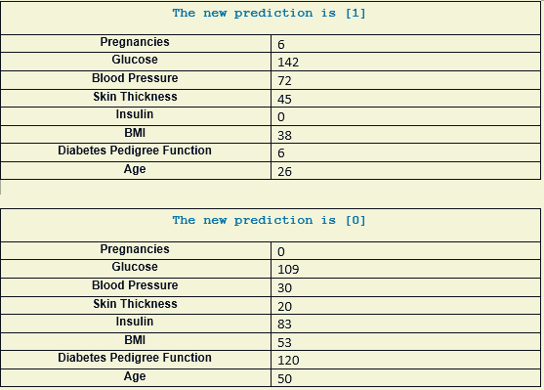
Predictions

Slide 11

Conclusion
I have accomplished a good results model
I develop four models:
KNeighborsClassifier and LogisticRegression and GaussianNB and RandomForestClassifier from those models I got one model that has very good results,
is (RandomForestClassifier)

Slide 12

Thank You

